Slide 1


Play Ground Use Case
1

Slide 2
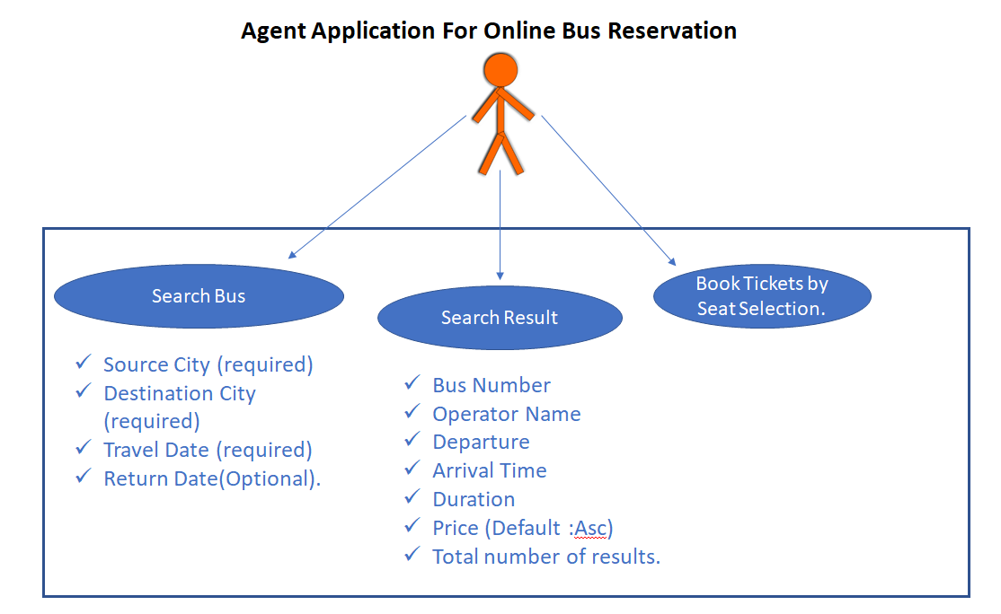
Objective is to Implement below API

Slide 3
Specification:-
Frameworks and Tools
Spring Boot
Oracle DB
H2 Database (Testing)
Rest API (Microservices)
Junit
JDK-11
Maven

Slide 4
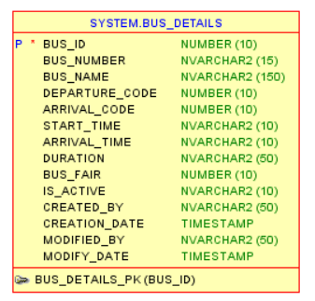
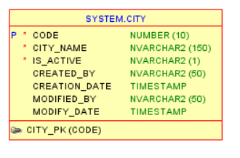
Database Design

Slide 5
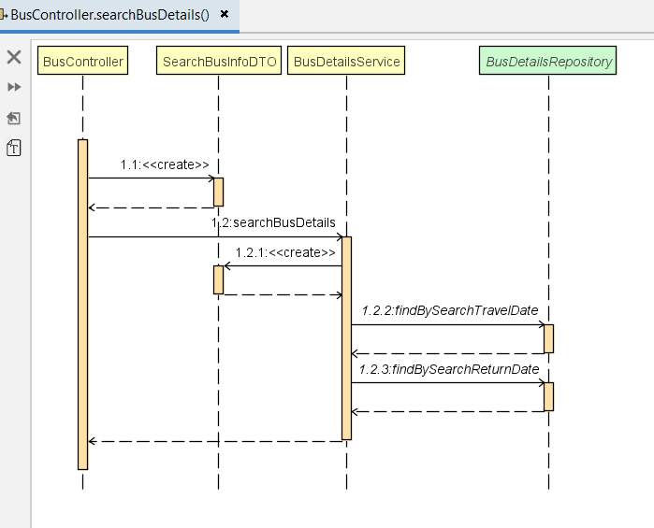
Sequence Diagram

Slide 6
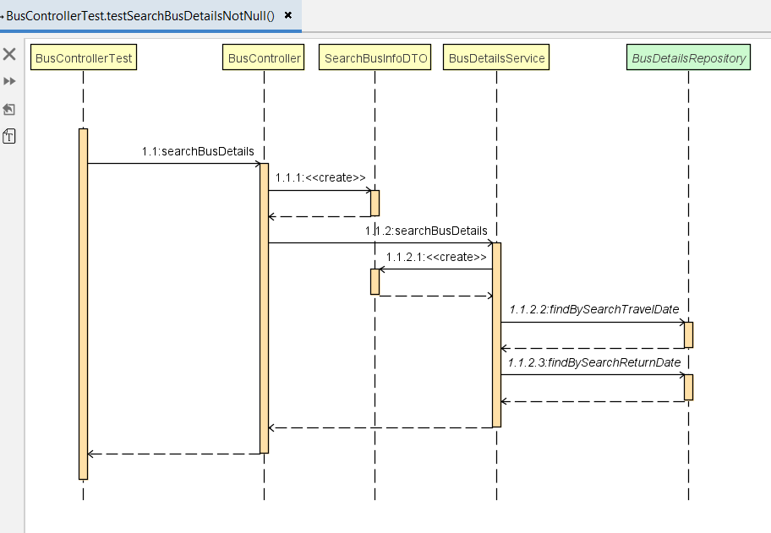
Sequence Diagram (Test)

Slide 7
Thank you
6

